Slide 1
Cloud Access and Cloud Interconnection Networks
Session 06
Course : COSC6100001 - Cloud Infrastructure
D6825 - Samuel Philip

Slide 2
Learning outcomes
(C4) Analysis : identify problems that can be solved using cloud global infrastructure
(C2) Comprehension : group Classify real-worlds problems in accordance with cloud computing infrastructure
(C4) Analysis : analyze identifying problems and choose proper Cloud Services and Cloud Infrastructure

Slide 3
Outline
Internet Evolution
Content-Centric Networks
Network Resource Management
Content Delivery Network

Slide 4
Internet Evolution

Slide 5
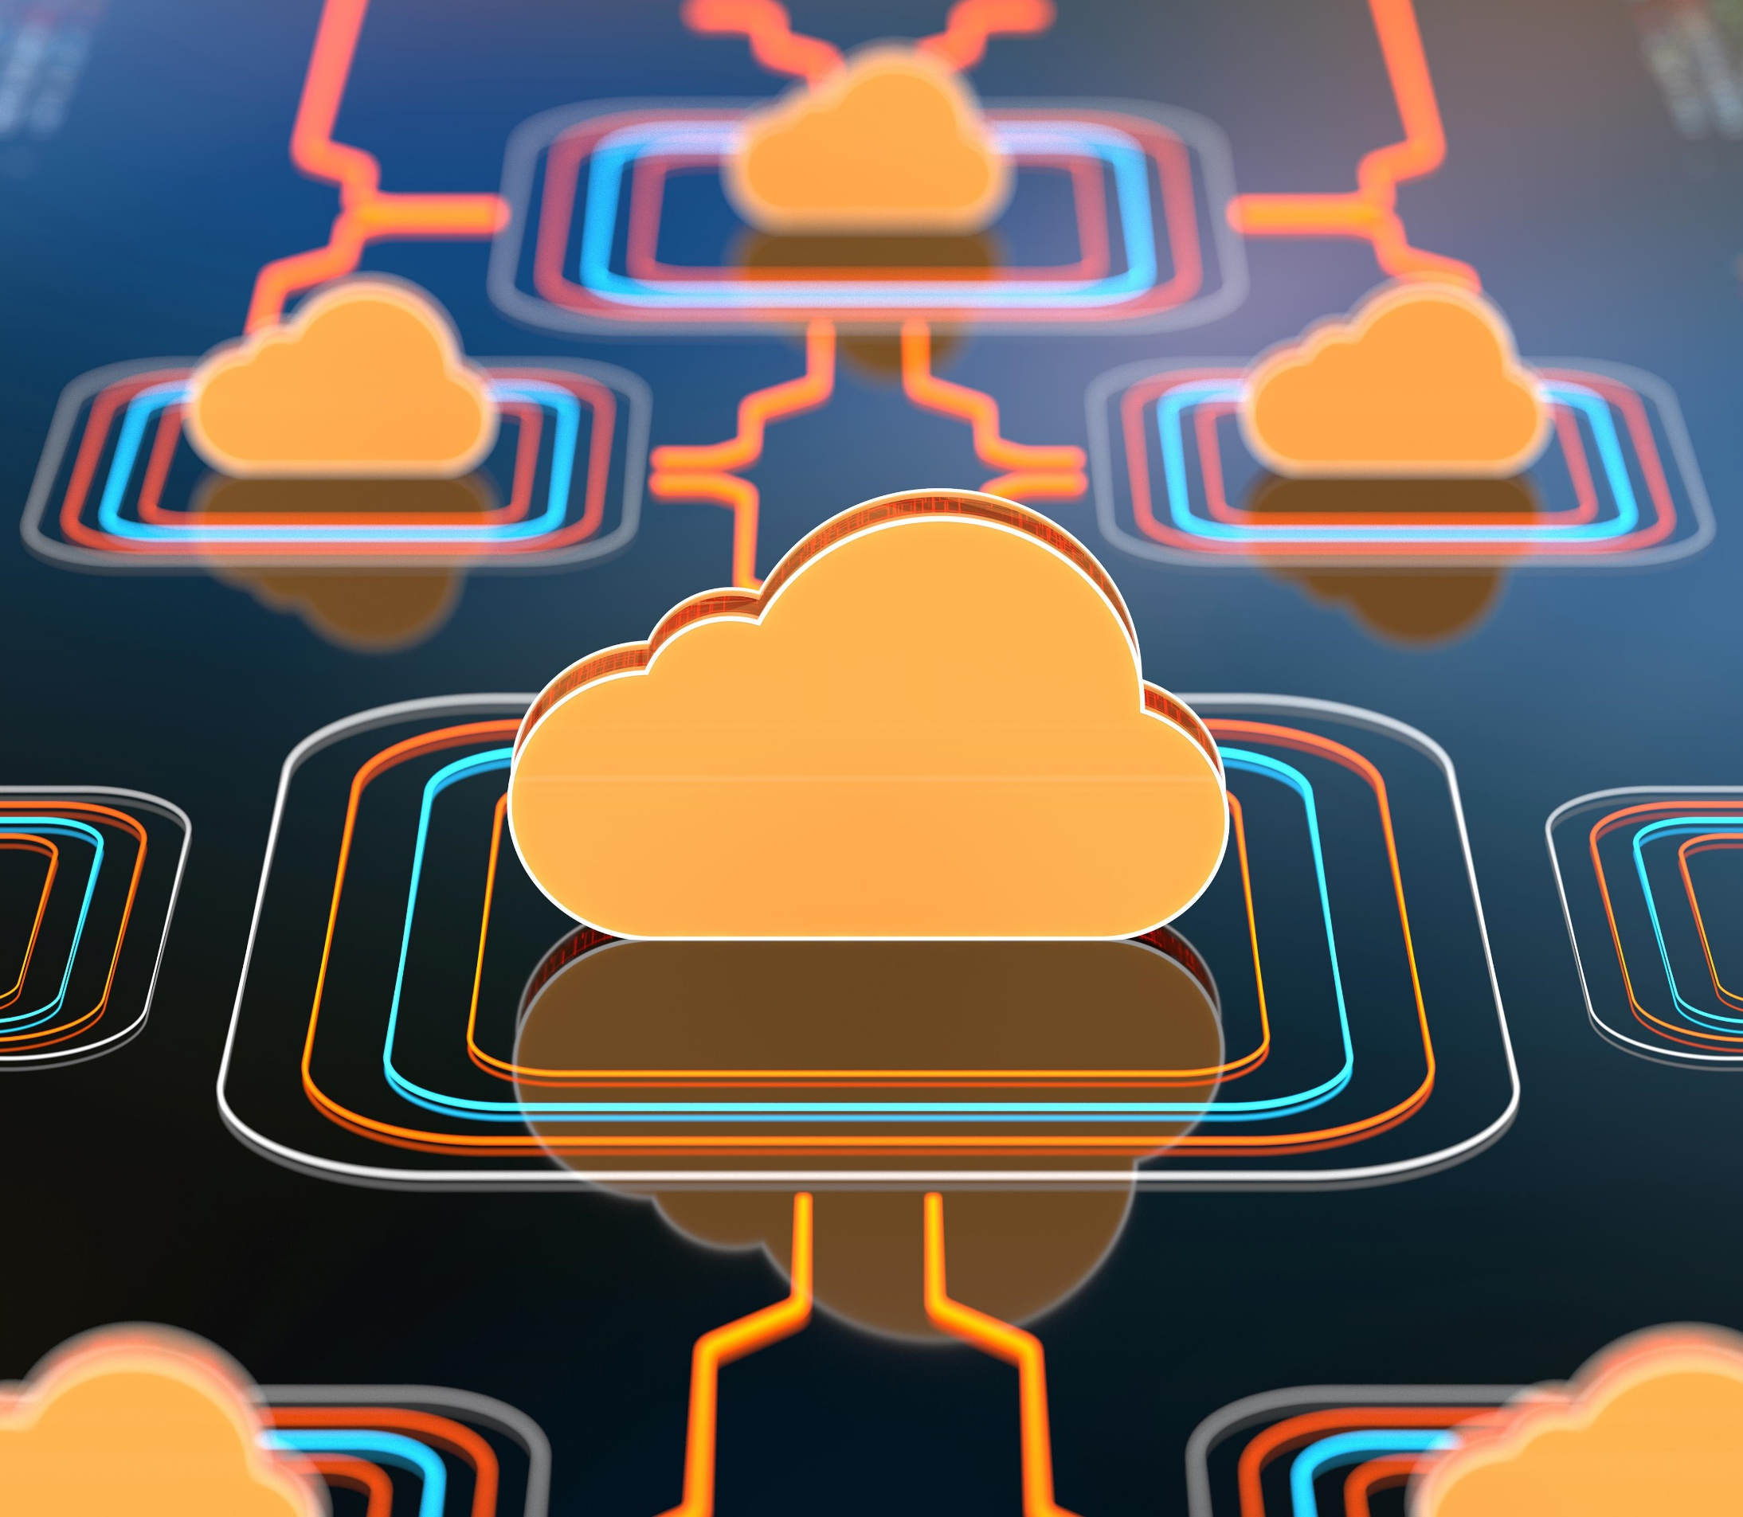
Internet Evolution
Initially conceived as a data network, a network designed to transport data files, the Internet has morphed into today's network supporting data streaming and applications with real-time constraints such as the Lambda service offered by the AWS.
There are some relationship between two networks.
Peering means that two networks exchange traffic between each other's customers freely.
Transit requires a network to pay another one for accessing the Internet.
The term customer means that a network is receiving money to allow Internet access.

Slide 6
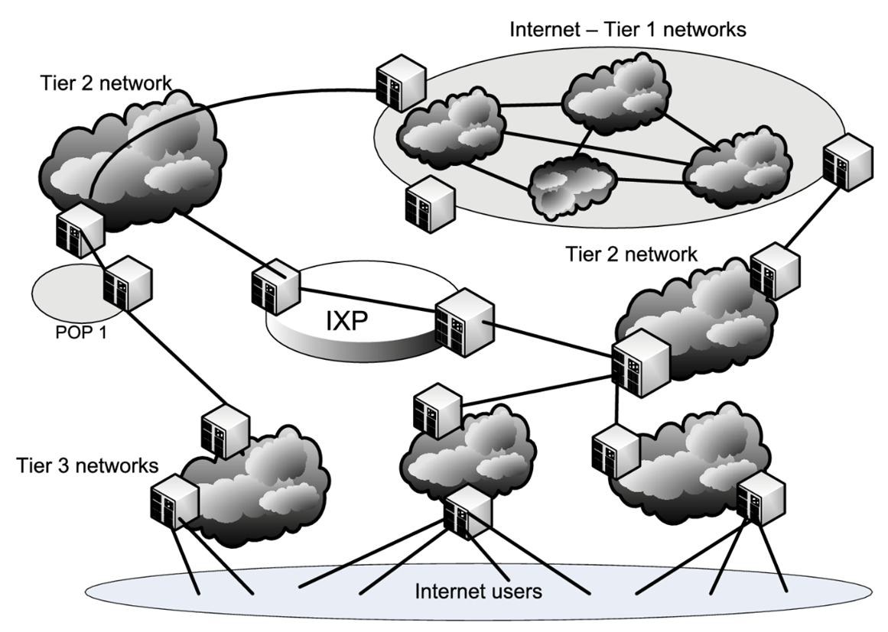
Network Classes
Based on these relationships, the networks are commonly classified as Tier 1, 2, and 3.
Tier 1 network can reach every other network on the Internet without purchasing IP transit or paying settlements; examples of Tier 1 networks are Verizon, ATT, NTT, and Deutsche Telecom.
Tier 2 network is an Internet service provider that engages in the practice of peering with other networks but still purchases IP transit to reach some portion of the Internet; Tier 2 providers are the most common providers on the Internet.
Tier 3 network purchases transit rights from other networks (typically Tier 2 networks) to reach the Internet. A point-of-presence (POP) is an access point from one place to the rest of the Internet.

Slide 7
Network Classes
More on that
Internet exchange point (IXP) is a physical infrastructure enabling Internet Service Providers (ISPs) to exchange Internet traffic.
IXPs interconnect networks directly via the exchange, rather than through one or more third-party networks.
The advantages of the direct interconnection are numerous, but the primary reasons to implement an IXP are cost, latency, and bandwidth.
IXPs reduce the portion of an ISP's traffic that must be delivered via their upstream transit providers, thereby reducing the average per-bit delivery cost of their service

Slide 8
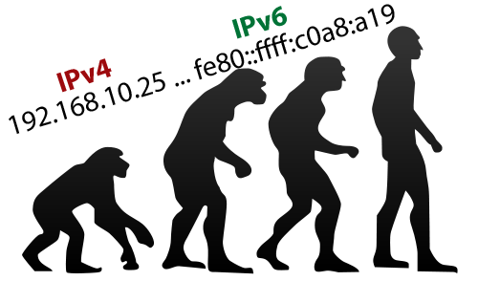
Internet protocol
Migration to IPV6
Internet Protocol, Version 4 (IPv4), provides an addressing capability of 232, or approximately 4.3 billion IP addresses, a number that proved to be insufficient
It sounds like a lot but by February 2011, The Internet Assigned Number Authority (IANA) assigned the last batch of five address block to the regional internet registries. Meaning that they ran out of address block (about 16.7 million possible addresses)
Internet Protocol Version 6 (IPv6) provides an addressing capability of 2128, or 3.4×1038 addresses.
This Photo by Unknown Author is licensed under CC BY-SA

Slide 9
Internet protocol
Ipv4 and ipv6 major differences
Multicasting
It sounds like a lot but by February 2011, The Internet Assigned Number Authority (IANA) assigned the last batch of five address block to the regional internet registries. Meaning that they ran out of address block (about 16.7 million possible addresses)
Internet Protocol Version 6 (IPv6) provides an addressing capability of 2128, or 3.4×1038 addresses.
This Photo by Unknown Author is licensed under CC BY-SA

Slide 10
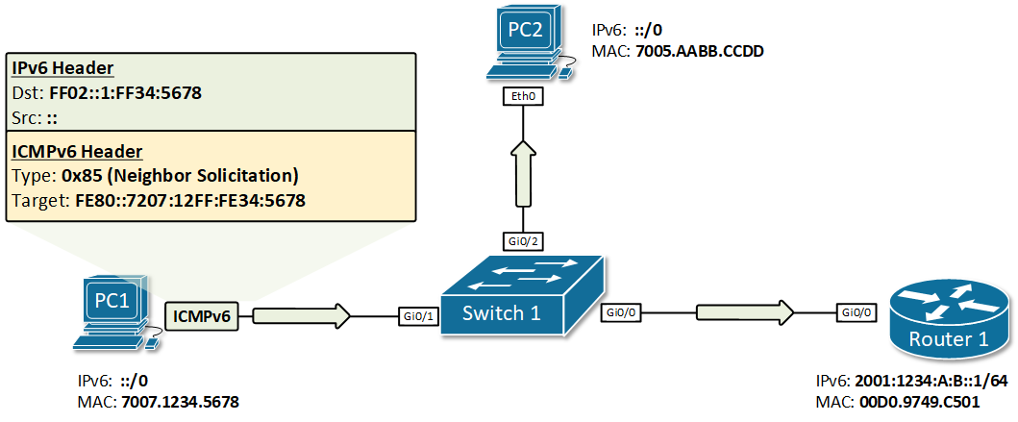
Internet protocol
Ipv4 and ipv6 major differences
Stateless address auto-configuration (SLAAC)
IPv6 hosts can configure themselves automatically using router-discovery messages when connected to a routed IPv6 network using ICMPv6 (Internet Control Message Protocol v6).
When first connected to a network, a host sends a link-local router solicitation multicast request for its configuration parameters. If suitably configured, routers respond to such a request with a router advertisement packet that contains network-layer configuration parameters.

Slide 11
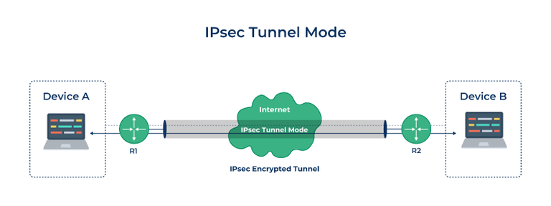
Internet protocol
Ipv4 and ipv6 major differences
Mandatory support for network security.
Internet Network Security (IPsec) is an integral part of the base protocol suite in IPv6, while it is optional for IPv4. IPsec is a protocol suite2 operating at the IP layer. Each IP packet is authenticated and encrypted. Other security protocols, e.g., Secure Sockets Layer (SSL), Transport Layer Security (TLS), and Secure Shell (SSH) operate at the upper layers of the TCP/IP suite.

Slide 12
Content-centric Network

Slide 13
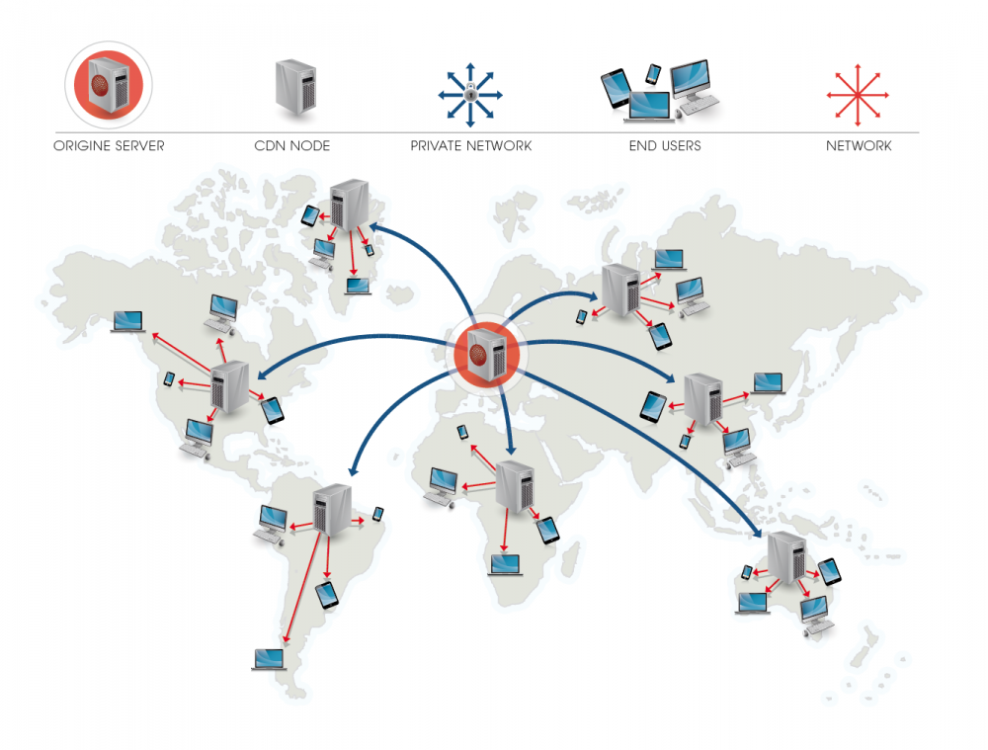
Content-centric network
The idea of a content-centric network has been around for some time.
In 1999, the TRIAD project at Stanford proposed to use an object name for routing towards the object replica.
In 2006 the Data Oriented Network Architecture (DONA) project at UC Berkeley extended TRIAD incorporating security and persistence as primitives of the new network architecture.
In 2006 Van Jacobson from UCLA argued that Named Data Networks (NDNs) should be the architecture of the future Internet.

Slide 14
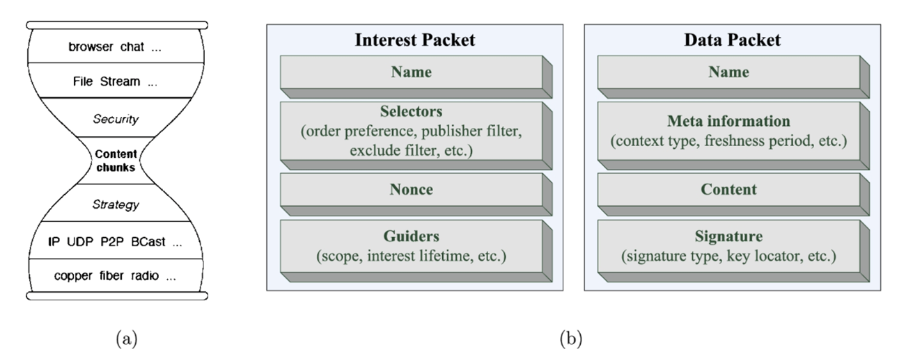
Content-centric network
In 2012, the Internet Research Task Force (IRTF) established an information-centric networking (ICN) research working group for investigating architecture designs for NDN.
The important features of the NDN architecture addressed by the current research efforts include namespaces, trust models, in-network storage, data synchronization, and, last but not least, rendezvous, discovery, and bootstrapping.
Named Data Network
Notes:
Named Data Networks.
NDN hourglass architecture parallels the one of the Internet; it separates the lower layers of the protocol stack from the upper ones, thus data naming can evolve independently from networking.
NDN networking service semantics is to fetch a data chunk identified by name, while Internet semantics is to deliver a packet to a given network address through an end-to-end channel identified by a source and a destination IP address. Interest packets and data packets are used for NDN routing and forwarding.

Slide 15
Content-centric network
NDN
The hourglass model can be extended, and packets can name objects rather than communication endpoints.
NDN's hourglass model separates the lower layers of the protocol stack from the upper ones, thus data naming can evolve independently from networking, as in (a). NDN packet delivery is driven by data consumers;
communication is initiated by an agent generating an Interest packet containing the name of the data as in (b).
Named Data Network
Notes:
Once the Interest packet reaches a network host that has a copy of the data item, a Data packet containing the name, the contents of the data, and the signature is generated.
The signature consists of producer's key. The data packet follows the route traced by the interest packet, and it is delivered to the data consumer agent.

Slide 16
Content-centric network
NDN
NDN is a universal overlay. NDN can run over any datagram network and, conversely, any datagram network, including IP, can run over NDN.
NDN could be useful for cloud data centers and, in particular, for those supporting the IaaS cloud delivery model. Data is replicated, and multiple instances could access data concurrently from their nearest storage servers. This would be useful for some MapReduce applications, but it would require major changes in frameworks supporting this paradigm.
Named Data Network
Notes:
Once the Interest packet reaches a network host that has a copy of the data item, a Data packet containing the name, the contents of the data, and the signature is generated.
The signature consists of producer's key. The data packet follows the route traced by the interest packet, and it is delivered to the data consumer agent.

Slide 17
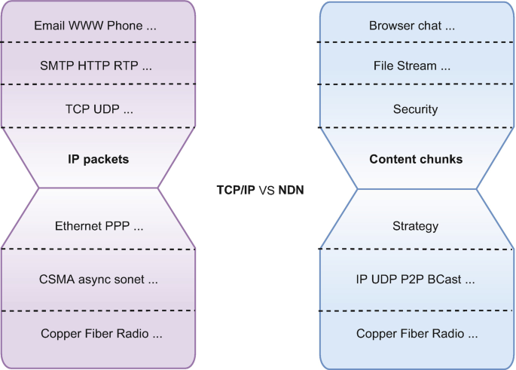
Content-centric network
Ndn vs tcp/ip
NDN are considered as the future of internet, but how does it different to TCP/IP
NDN namespace cannot be exhausted, while IPv4 address limitation forced migration to IPv6.
NDN supports data-centric security; each Data packet is cryptographically signed, while TCP/IP security is left to the communication endpoints.
An NDN router announces name prefixes for data it is willing to serve, while an IP router announces IP prefixes.

Slide 18
Network Resource management

Slide 19
Network Resource Management
A critical aspect of resource management in cloud computing is to guarantee the communication bandwidth required by an application as specified by an SLA. The solutions to this problem are based on the strategies used for some time on the Internet to support the data streaming QoS requirements.
A first strategy to avoid network congestion is to use a FCFS scheduling algorithm. The advantage of FCFS algorithm is a simple management of the three quantities: bandwidth, timing, and buffer space. Nevertheless, the FCFS algorithm does not guarantee fairness; greedy flow sources can transmit at a higher rate and benefit from a larger share of the bandwidth.

Slide 20
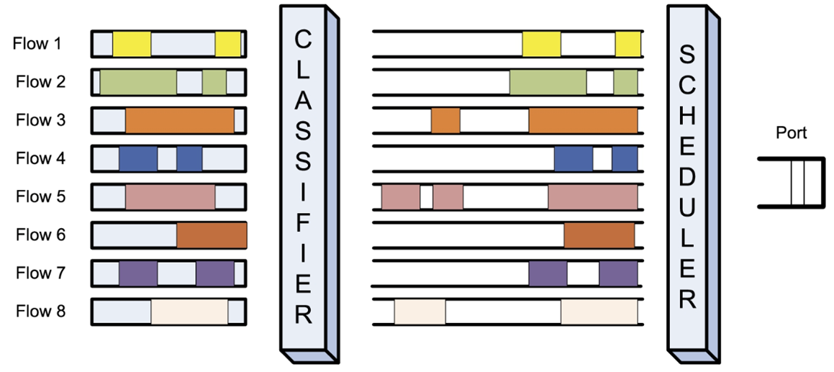
Network Resource Management
Fair queueing
The algorithm ensures that a high-data-rate flow cannot use more than its fair share of the link capacity.
Packets are first classified into flows by the system and then assigned to a queue dedicated to the flow. Packet queues are serviced one packet at a time in round-robin (RR) order.
FQ's objective is max-min fairness. This means that it maximizes first the minimum data rate and then the second minimum data rate of any data flow. Starvation of expensive flows is avoided, but the throughput is low.
The FQ algorithm guarantees buffer space management fairness but does not guarantee fairness of bandwidth allocation; a flow transporting large packets will benefit from a larger bandwidth.
Notes:
Fair Queuing—packets are first classified into flows by the system and then assigned to a queue dedicated to the flow; queues are serviced one packet at a time in round-robin order and empty queues are skipped.

Slide 21
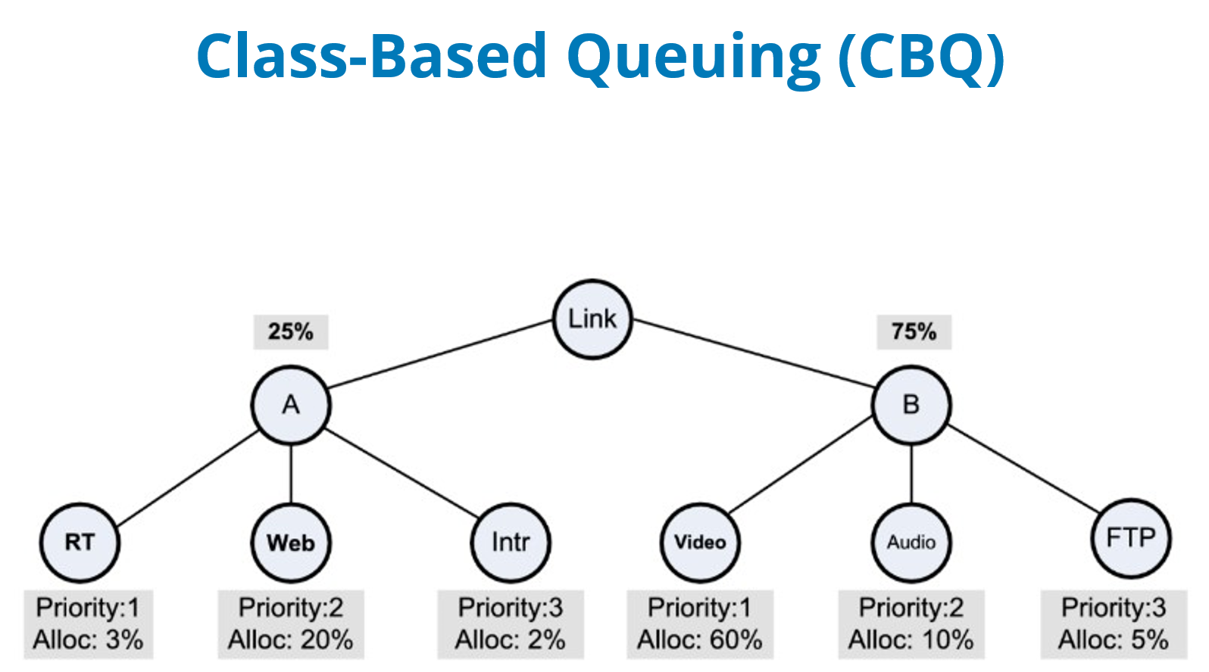
Network Resource Management
Class-Based Queuing (CBQ)
This algorithm is a widely used strategy for link sharing proposed by Sally Floyd and Van Jacobson in 1995.
The objective of CBQ is to support flexible link sharing for applications that require bandwidth guarantees such as VoIP, video streaming, and audio streaming.
CBQ supports some balance between short-lived network flows, such as web searches, and long-lived ones, such as video streaming or file transfers.
CBQ aggregates connections and constructs a hierarchy of classes with different priorities and throughput allocations.
Notes:
CBQ link sharing for two groups A, of short-lived traffic, and B, of long-lived traffic, allocated 25% and 75% of the link capacity, respectively.
There are six classes of traffic with priorities 1, 2, and 3. The RT (real-time) and the video streaming have priority 1 and are allocated 3% and 60%, respectively, of the link capacity.
Web transactions and audio streaming have priority 2 and are allocated 20% and 10%, respectively of the link capacity.
Intr (interactive applications) and FTP (file transfer protocols) have priority 3 and are allocated 2% and 5%, respectively, of the link capacity.

Slide 22
Network Resource Management
Class-Based Queuing (CBQ)
Functional units of CBQ
a classifier uses the information in the packet header to assign arriving packets to classes;
an estimator of the short-term bandwidth for the class;
a selector, or scheduler, identifies the highest priority class to send next and, if multiple classes have the same priority, to schedule them on a round-robin base; and
a delayer to compute the next time when a class that has exceeded its link allocation is allowed to send.
Notes:
CBQ link sharing for two groups A, of short-lived traffic, and B, of long-lived traffic, allocated 25% and 75% of the link capacity, respectively.
There are six classes of traffic with priorities 1, 2, and 3. The RT (real-time) and the video streaming have priority 1 and are allocated 3% and 60%, respectively, of the link capacity.
Web transactions and audio streaming have priority 2 and are allocated 20% and 10%, respectively of the link capacity.
Intr (interactive applications) and FTP (file transfer protocols) have priority 3 and are allocated 2% and 5%, respectively, of the link capacity.

Slide 23
Content Delivery Network

Slide 24
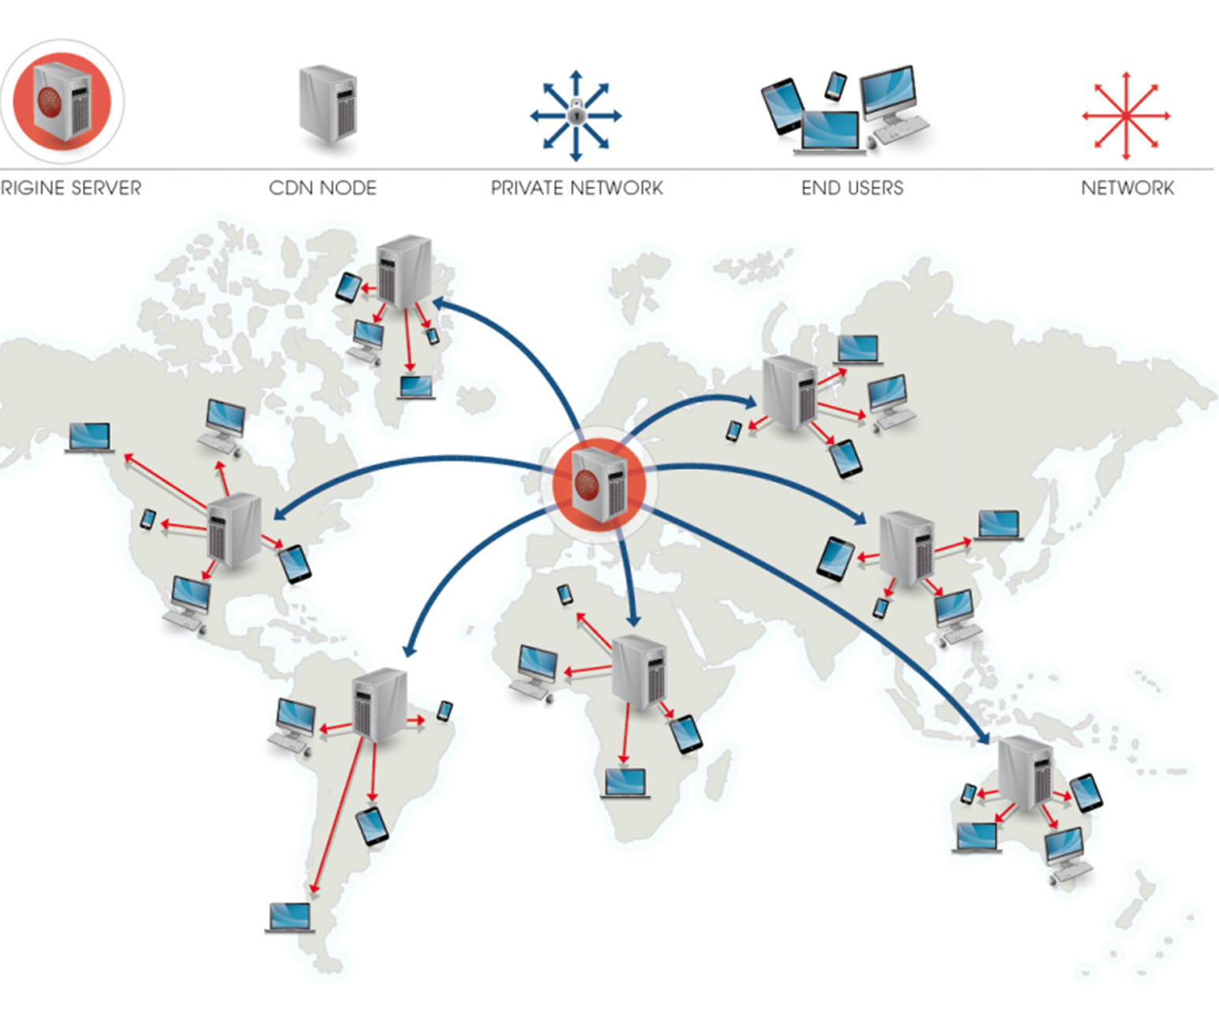
Content Delivery Network
Computer clouds support network-centric computing and network-centric content.
The vast amount of data stored on the cloud has to be delivered efficiently to a large user population and Content Delivery Networks (CDNs) offer fast and reliable content delivery and reduce communication bandwidth by caching and replication.
A CDN receives the content from an Origin server, then replicates it to its Edge cache servers; the content is delivered to an end-user from the “closest” Edge server.

Slide 25
Content Delivery Network
CDNs support scalability, increase reliability and performance, and provide better security.
CDNs place additional resources provisioned to absorb the traffic caused by flash crowds and, in general, to provide capacity on demand.
A CDN uses two types of servers: the origin server updated by the content provider and replica servers, which cache the content and serve as authoritative reference for client requests.

Slide 26
Content Delivery Network
CDNs deliver static content and/or live or on-demand streaming media.
Static content refers to media stored using traditional caching technologies because changes are infrequent. Examples of static content are: HTML pages, images, documents, software patches, and audio and/or video files.
Live media refers to live events when the content is delivered in real time from the encoder to the media server.

Slide 27
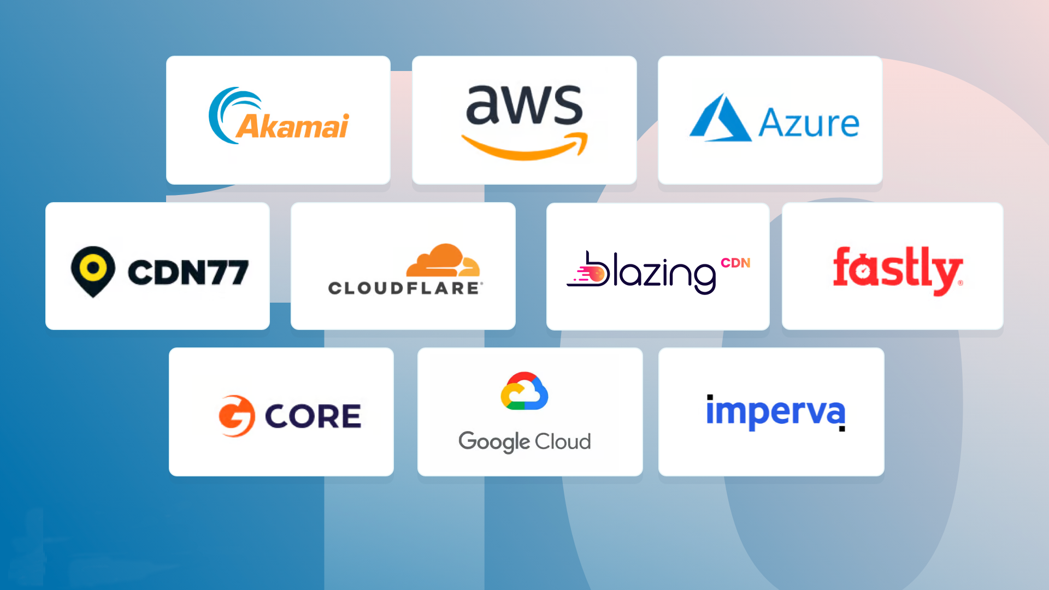
Content Delivery Network
CDN Providers
There are several other active commercial CDNs including EdgeStream providing video streaming and Limelight Networks providing on-demand and live delivery of video, music, and games.
There are several academic CDNs: Coral is a freely available network designed to mirror web content, hosted on PlanetLab; Globule is an open-source collaborative CDN developed at Vrije Universiteit in Amsterdam.

Slide 28
Content Delivery Network
CDN organization
There are two strategies for CDN organization.
The first strategy is based exclusively on content replication on multiple caches and redirection based on proximity to the end-user.
In the second approach the network core elements redirect content requests to local caches or redirect data center's incoming traffic to servers optimized for specific content type access. Some CDNs including Akamai use both strategies.

Slide 29
CDN Design and Policy Decisions
(i) the placement of the edge servers;
(ii) the content selection and delivery;
(iii) content management; and
(iv) request routing policies.

Slide 30
CDN Performance Metrics
cache hit ratio—the ratio of the number of cached objects versus total number of objects requested;
reserved bandwidth for the origin server;
latency—based on the perceived response time by the end users;
edge server utilization; and,
reliability—based on packet loss measurements.

Slide 31
Exercise
Find example use case of CDN
how it changes the internet and content delivery

Slide 32
References
Marinescu, Dan C. (2022). Cloud Computing Theory and Practice: 3rd Edition. Morgan Kaufmann Publishers. ISBN: 978-0-323-85277-7
Network Resource Management
https://docs.oracle.com/cd/E36784_01/html/E36813/gecki.html

Slide 33
Thankyou

